Slide 1
DSA 3050A · Group 05
Airline Delay and Operations Intelligence
Houston, 2011 — 227,496 flights
DSA 3050A — Business Intelligence & Visualization · Group 05
J. P. Chawanda · Catherine Ingabire · Ruth Musanhu · Faith Chakwanira · Racheal H. Skiven-data

Slide 2
Part 1: Airline Delay and Operations Intelligence

Slide 3
The Business Problem
Houston Airport System — Operations Performance
Delay is the largest controllable cost in airport operations — fuel, crew duty limits, gate reallocation, missed connections, compensation.
Houston ran 227,496 departures in 2011. 47.8% of operated flights arrived late.
Management could see that the network was late — not where the lateness was being created.
Without attribution, mitigation spending is guesswork.
Our brief: attribute delay and cancellation to the carrier, route, airport, hour and month that produced them.
DSA 3050A · Group 05 — Airline Delay & Operations Intelligence
3

Slide 4
The Data
hflights — Houston departures, 2011
227,496
21
15
149
116
FLIGHTS
COLUMNS
AIRLINES
ROUTES
DESTINATIONS
Source: US DOT Bureau of Transportation Statistics, via the R hflights package — genuine public government reporting.
Period: every commercial departure from IAH and HOU in 2011.
Structurally clean: zero duplicates, zero blank rows — but times stored as HHMM integers, flags as 0/1, and a 98.69% null rate on cancellation code.
DSA 3050A · Group 05 — Airline Delay & Operations Intelligence
4

Slide 5
Cleaning and Modelling
One fact table, three dimensions, 22 measures
All 10 required cleaning tasks, and 8 advanced tasks against a requirement of 6.
Renamed 13 columns to business language; decoded every code and flag.
Split HHMM integers into real clock times; merged origin and destination into a Route key.
Derived Flight Status, Delay Category, Distance Band, Time of Day, Season and Delay Recovered.
Star schema: Fact_Flights + Dim_Date + Dim_Airline + a Group By aggregate table, measures isolated in _Measures.
The decision that mattered: 3,622 null arrival delays belong to cancelled and diverted flights. We left them null. Filling them with zero would have counted 3,622 flights that never arrived as "on time".
DSA 3050A · Group 05 — Airline Delay & Operations Intelligence
5

Slide 6
Part 2: Power Query Data Preparation and Transformation

Slide 7
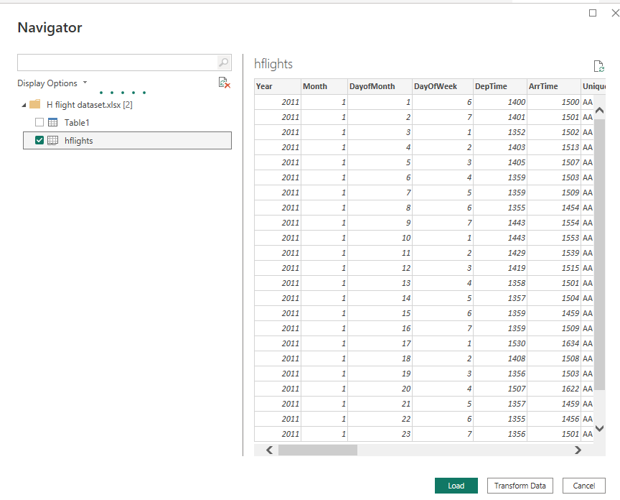
1. Importing the Data
The hflights table is selected, then sent to Transform Data instead of Load.
DSA 3050A · Group 05 — Airline Delay & Operations Intelligence
9

Slide 8
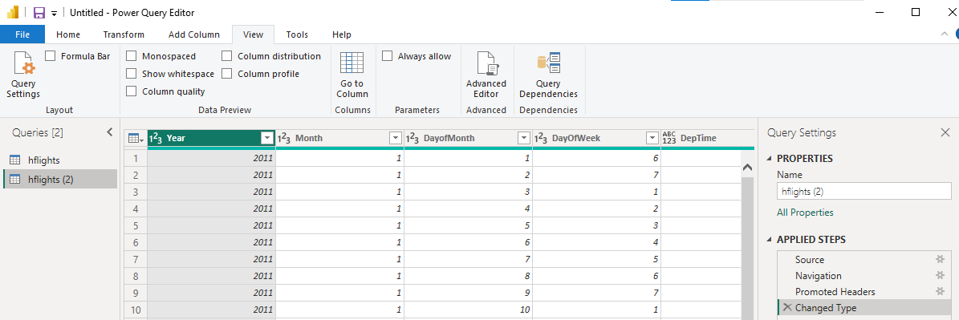
1. Data in the power query
Power Query Editor after load. Two queries exist (hflights, hflights (2)). Auto steps: Source, Navigation, Promoted Headers, Changed Type.
DSA 3050A · Group 05 — Airline Delay & Operations Intelligence
10

Slide 9
2. Basic Cleaning
DSA 3050A · Group 05 — Airline Delay & Operations Intelligence
11

Slide 10
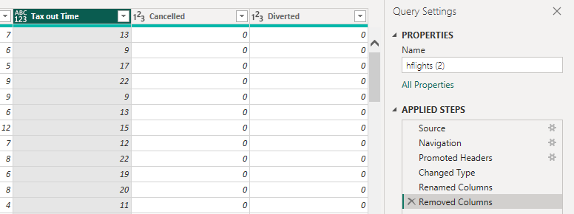
2.1 Rename and Delete Columns
Columns renamed, then unneeded columns (Cancelled, Diverted) removed.
DSA 3050A · Group 05 — Airline Delay & Operations Intelligence
12

Slide 11
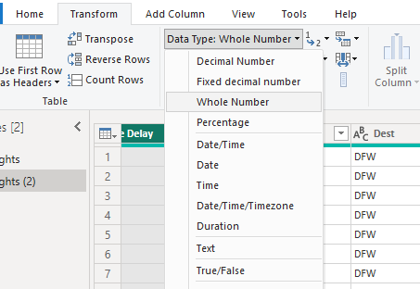
2.2 Change the Data Types
Data type set to Whole Number for a numeric column.
DSA 3050A · Group 05 — Airline Delay & Operations Intelligence
13

Slide 12
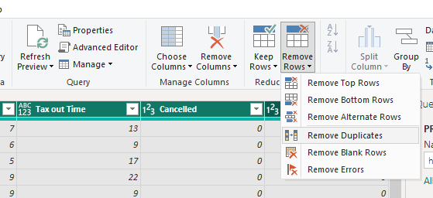
2.3 Remove Duplicate and Blank Rows
Remove Rows > Remove Duplicates, then Remove Blank Rows.
DSA 3050A · Group 05 — Airline Delay & Operations Intelligence
14

Slide 13
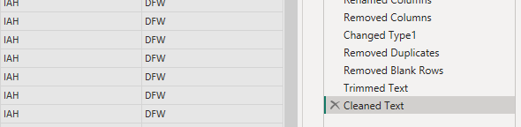
2.4 Trim Text and Clean
Format > Trim applied to remove extra spaces from text columns.
DSA 3050A · Group 05 — Airline Delay & Operations Intelligence
15

Slide 14
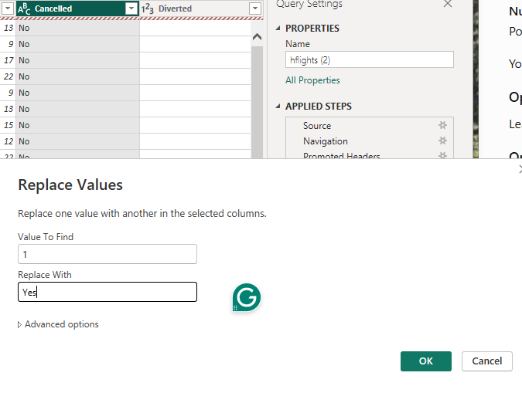
2.5 Replace Inconsistent Values
Replace Values coded entries (e.g. "1") replaced with readable labels (e.g. "Yes").
DSA 3050A · Group 05 — Airline Delay & Operations Intelligence
16

Slide 15
2.6 Handle Missing Values
"NA" entries left blank/null instead of filled in, so averages aren't skewed.
DSA 3050A · Group 05 — Airline Delay & Operations Intelligence
17

Slide 16
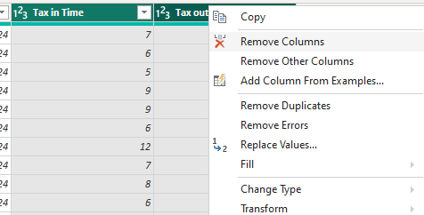
2.7 Remove Unnecessary Columns
Right-click > Remove Columns to drop further unneeded fields (e.g. taxi times).
DSA 3050A · Group 05 — Airline Delay & Operations Intelligence
18

Slide 17
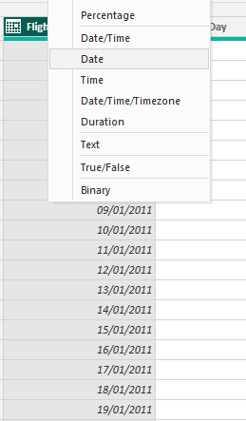
3.1 Fix Flight Date Type
Flight Date column type set to Date for correct sorting and filtering.
DSA 3050A · Group 05 — Airline Delay & Operations Intelligence
20

Slide 18
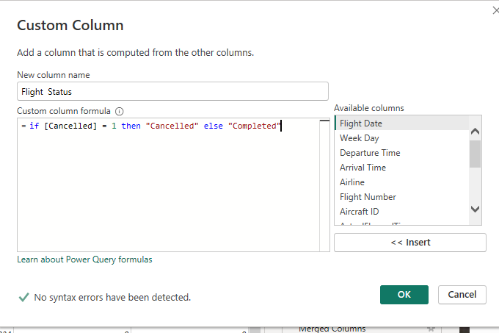
3.2 Create a Custom Column
Custom column "Flight Status" added:
= if [Cancelled] = 1 then "Cancelled" else "Completed"
DSA 3050A · Group 05 — Airline Delay & Operations Intelligence
21

Slide 19
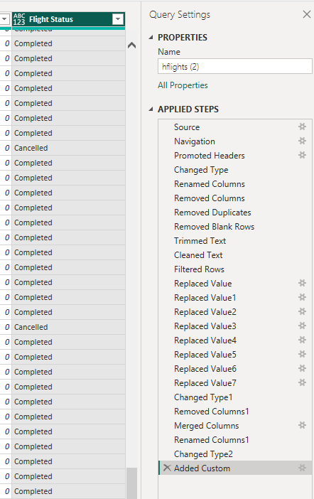
3.2 Create a Custom Column (cont.)
Flight Status column populated; Applied Steps show the full pipeline so far.
DSA 3050A · Group 05 — Airline Delay & Operations Intelligence
22

Slide 20
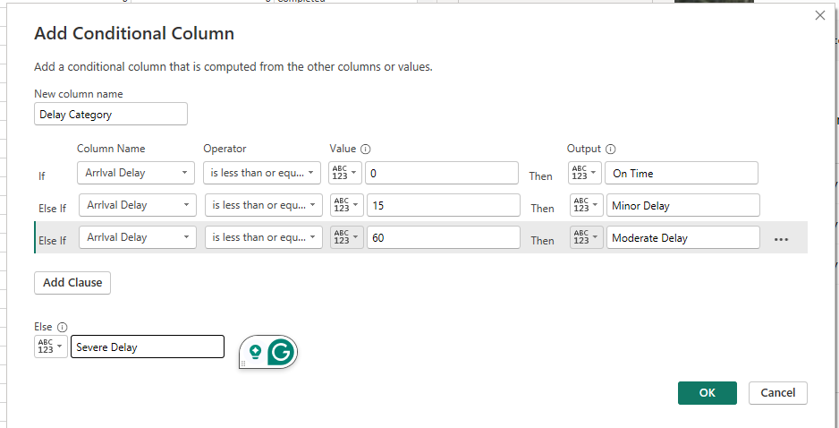
3.3 Create a Conditional Column
"Delay Category" built from Arrival Delay: On Time / Minor Delay / Moderate Delay / Severe Delay.
DSA 3050A · Group 05 — Airline Delay & Operations Intelligence
23

Slide 21
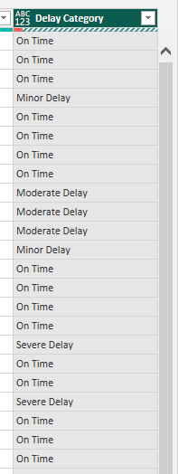
3.3 Create a Conditional Column (cont.)
Delay Category column populated as expected.
DSA 3050A · Group 05 — Airline Delay & Operations Intelligence
24

Slide 22
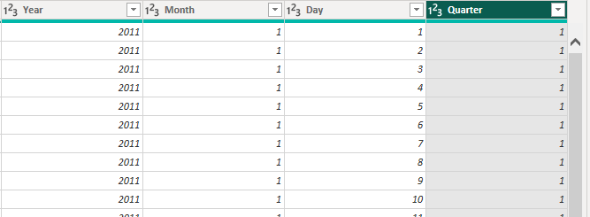
3.4 Extract Date Parts
Year, Month, Day, and Quarter extracted from Flight Date into separate columns.
DSA 3050A · Group 05 — Airline Delay & Operations Intelligence
25

Slide 23
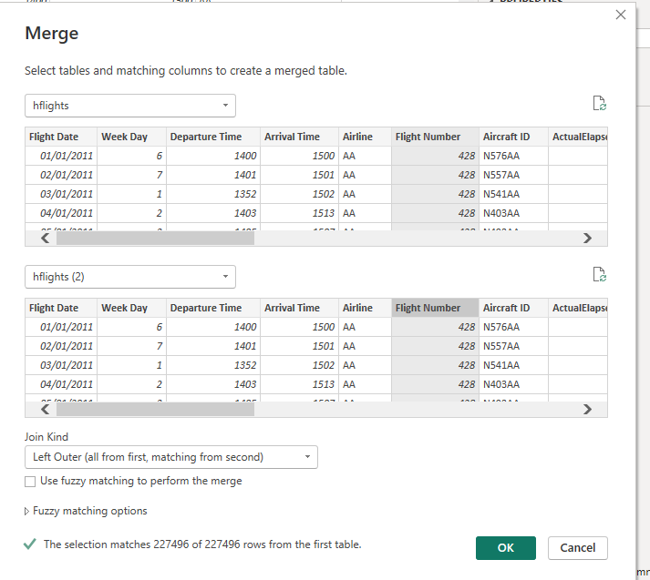
4. Advanced Tasks
4.1 Merge Queries
hflights merged with hflights (2), Left Outer join — 227,496 of 227,496 rows matched.
DSA 3050A · Group 05 — Airline Delay & Operations Intelligence
27

Slide 24
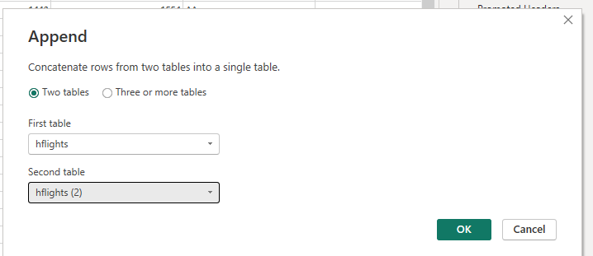
4.2 Append Queries
hflights and hflights (2) appended (stacked) into one table.
DSA 3050A · Group 05 — Airline Delay & Operations Intelligence
28

Slide 25
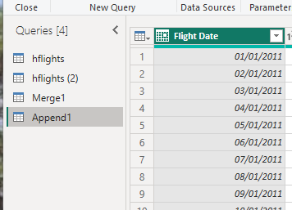
4.2 Append Queries (cont.)
New Append1 query confirms the combined table.
DSA 3050A · Group 05 — Airline Delay & Operations Intelligence
29

Slide 26
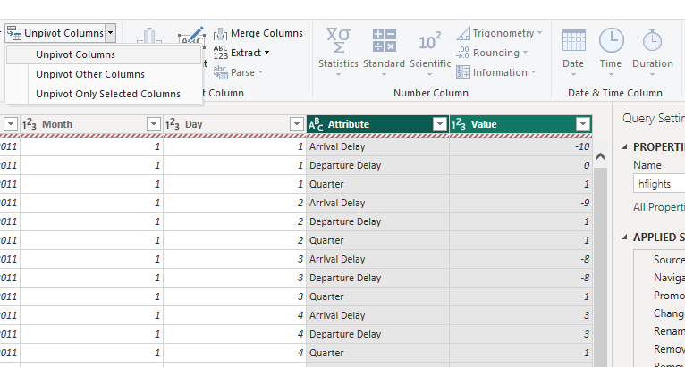
4.3 Unpivot Columns
Unpivot Columns used to reshape wide columns into Attribute/Value pairs.
DSA 3050A · Group 05 — Airline Delay & Operations Intelligence
30

Slide 27
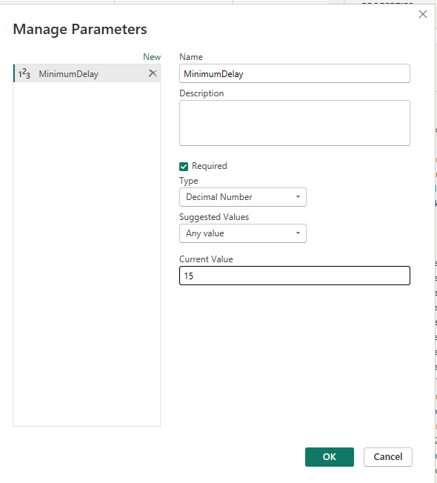
4.4 Create New Parameters
Parameter "MinimumDelay" created — Decimal Number, current value 15.
DSA 3050A · Group 05 — Airline Delay & Operations Intelligence
31

Slide 28
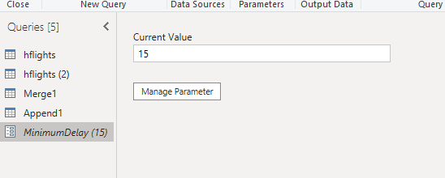
4.4 Create New Parameters (cont.)
MinimumDelay parameter appears in the Queries list, ready to be referenced.
DSA 3050A · Group 05 — Airline Delay & Operations Intelligence
32

Slide 29
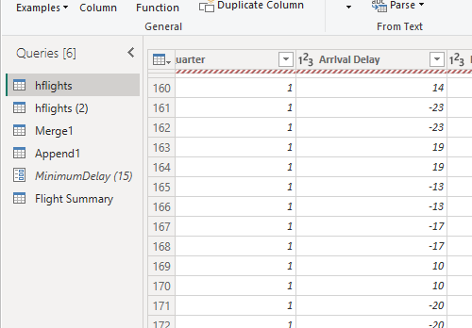
4.5 Create a Reference Query
"Flight Summary" created as a reference query, built on an existing query's output.
DSA 3050A · Group 05 — Airline Delay & Operations Intelligence
33

Slide 30
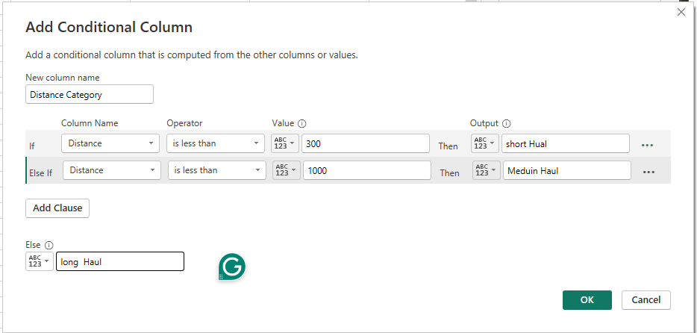
4.6 Nested Conditional Column
"Distance Category" built from Distance: short Haul / Medium Haul / long Haul.
DSA 3050A · Group 05 — Airline Delay & Operations Intelligence
34

Slide 31
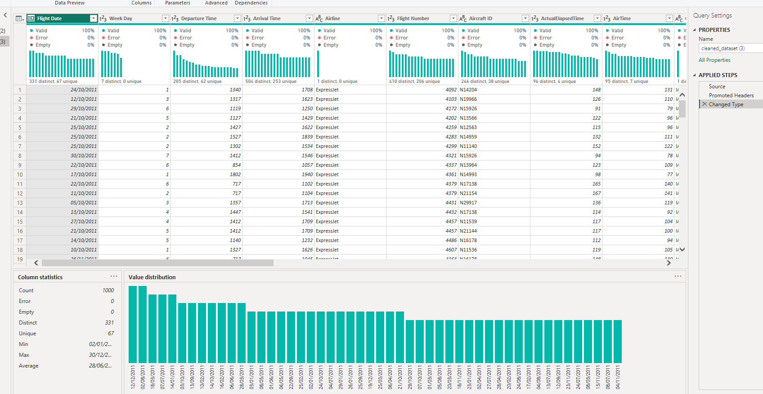
4.6 Column distribution, column profiling, column quality
DSA 3050A · Group 05 — Airline Delay & Operations Intelligence
35

Slide 32
Part 3: Data Modelling

Slide 33
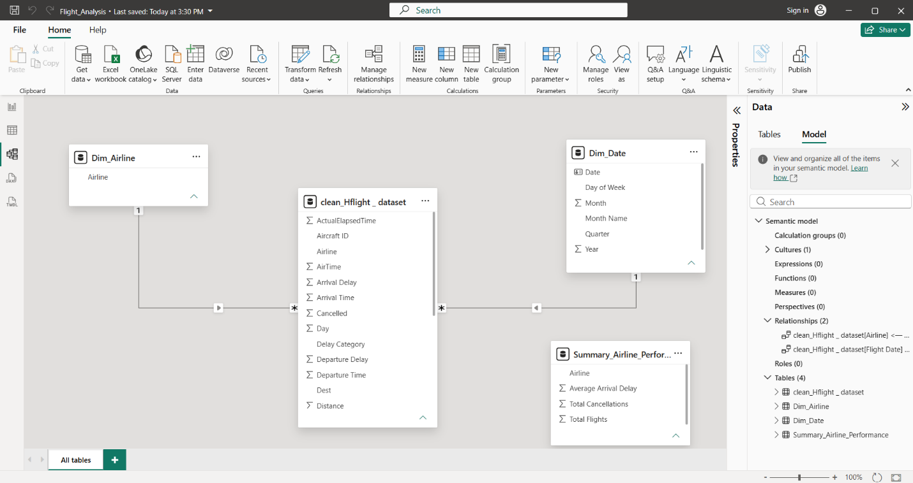
Data Modelling
Star Schema design pattern
The Power BI data model for the Airline Delay and Operations Dashboard is constructed using a standard Star Schema design pattern. The model separates quantitative transactional data (facts) from descriptive background details (dimensions) to ensure optimal query performance, clear data relationships, and intuitive reporting.
DSA 3050A · Group 05 — Airline Delay & Operations Intelligence
37

Slide 34
The Model — Four Primary Tables
clean_Hflight_dataset (Central Fact Table)
Dim Airline (Dimension Table)
Dim_Date (Dimension Table)
Summary_Airline_Performance (Aggregated Table)
DSA 3050A · Group 05 — Airline Delay & Operations Intelligence
38

Slide 35
Table Classification & Structural Interpretation
A. Central Fact Table: clean_Hflight_dataset
Classification: Fact Table.
Interpretation: This table serves as the primary engine for analysis. It stores individual flight record details and transactional metrics. It contains numerical fields required to calculate Key Performance Indicators (KPIs), such as Arrival Delay, Departure Delay, AirTime, Distance, ActualElapsedTime, and operational flags such as Cancelled.
DSA 3050A · Group 05 — Airline Delay & Operations Intelligence
39

Slide 36
Dimension Tables: Dim_Airline & Dim_Date
Classification: Dimension Tables (Lookup Tables).
Interpretation: These tables provide descriptive attributes that allow users to filter, group, and slice the flight metrics stored in the Fact table.
Dim_Airline: Contains distinct airline identifiers (Airline), allowing the dashboard to break down performance, delays, and cancellations by carrier.
Dim_Date: Contains detailed temporal attributes (Date, Day of Week, Month, Month Name, Quarter, Year). This enables trend analysis, identifying peak travel periods, seasonal delay patterns, and month-over-month performance.
DSA 3050A · Group 05 — Airline Delay & Operations Intelligence
40

Slide 37
Standalone Summary Table: Summary_Airline_Performance
Classification: Aggregated Reference Table.
Interpretation: Contains pre-calculated summary metrics (Average Arrival Delay, Total Cancellations, Total Flights) per airline. It acts as an auxiliary table for high-level summary cards or quick verification against detailed DAX measures.
DSA 3050A · Group 05 — Airline Delay & Operations Intelligence
41

Slide 38
Data Relationships and Cardinality
The integrity of the model is maintained through proper database relationships
Dim_Airline to clean_Hflight_dataset — Cardinality: One-to-Many (1:*). Direction: single-direction filter flowing from Dim_Airline to clean_Hflight_dataset. Meaning: a single airline in the dimension table links to multiple flight records in the fact table; filtering by an airline automatically isolates all relevant flights for that carrier.
Dim_Date to clean_Hflight_dataset — Cardinality: One-to-Many (1:*). Direction: single-direction filter flowing from Dim_Date to clean_Hflight_dataset. Meaning: a unique calendar date connects to multiple flights occurring on that day; selecting a month, quarter, or date range dynamically filters all operational metrics in the fact table.
DSA 3050A · Group 05 — Airline Delay & Operations Intelligence
42

Slide 39
Part 4: DAX Measures

Slide 40
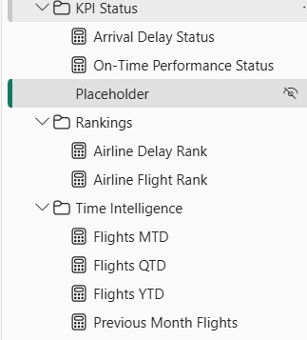
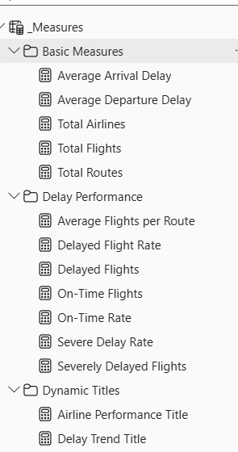
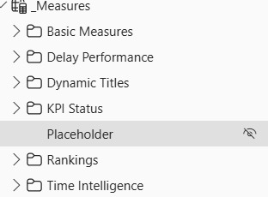
DAX Measures
We created and tested 22 DAX measures covering flight volumes, delay performance, time intelligence, percentages, rankings, KPI statuses and dynamic titles. The measures were organised into display folders and prepared for use in KPI cards, trend charts, ranking tables, slicers and drill-through analysis.
DSA 3050A · Group 05 — Airline Delay & Operations Intelligence
44

Slide 41
Part 5: Advanced Dashboard Design and Visuals

Slide 42
Airline Delay and Operations Dashboard
DSA 3050A · Group 05 — Airline Delay & Operations Intelligence
46

Slide 43
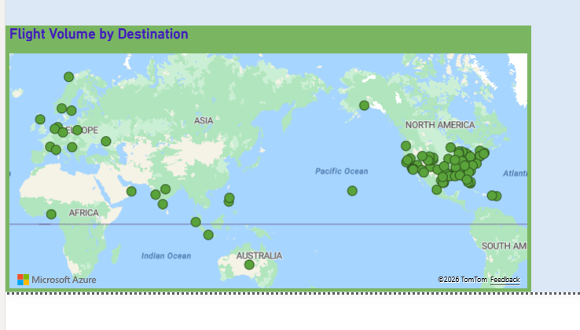
1. Geographic and Segment Analysis — Flight Volume by Destination
My section focused on analysing flight destinations, airline performance, monthly activity and delay patterns using Power BI. The map was used to show how flights are distributed across different destinations. The results show that flight activity is concentrated in certain areas, particularly North America. Some destinations have much higher flight volumes than others.
DSA 3050A · Group 05 — Airline Delay & Operations Intelligence
47

Slide 44
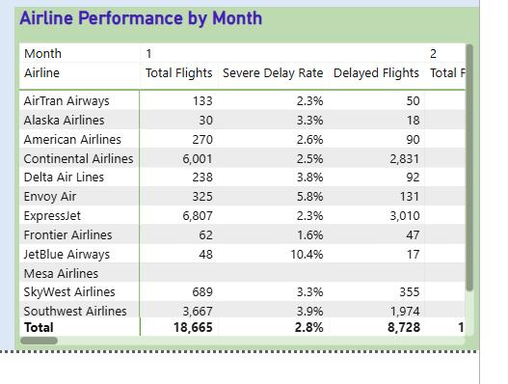
Airline Performance by Month
The matrix compares airlines across months using Total Flights, Delayed Flights and Severe Delay Rate. For example, in Month 1, Continental Airlines recorded approximately 6,001 flights, while Southwest Airlines recorded 3,667 flights. Southwest had a severe delay rate of 3.9%, compared with 2.5% for Continental.
DSA 3050A · Group 05 — Airline Delay & Operations Intelligence
48

Slide 45
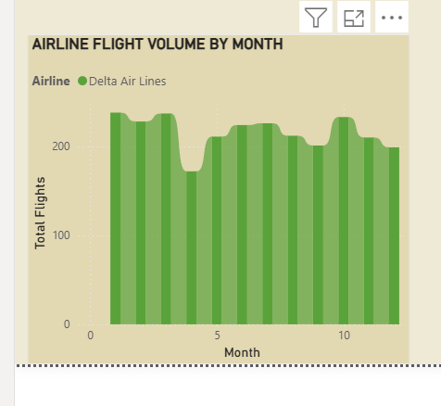
Monthly Flight Activity
The ribbon chart was used to examine changes in airline flight activity across months. It shows that flight volumes vary throughout the year, helping identify possible seasonal travel patterns.
DSA 3050A · Group 05 — Airline Delay & Operations Intelligence
49

Slide 46
2. Detailed Airline Analysis
DSA 3050A · Group 05 — Airline Delay & Operations Intelligence
50

Slide 47
Detailed Airline Analysis — Drill-through
A drill-through page was created to allow users to select an airline and view its detailed performance.
DSA 3050A · Group 05 — Airline Delay & Operations Intelligence
51

Slide 48
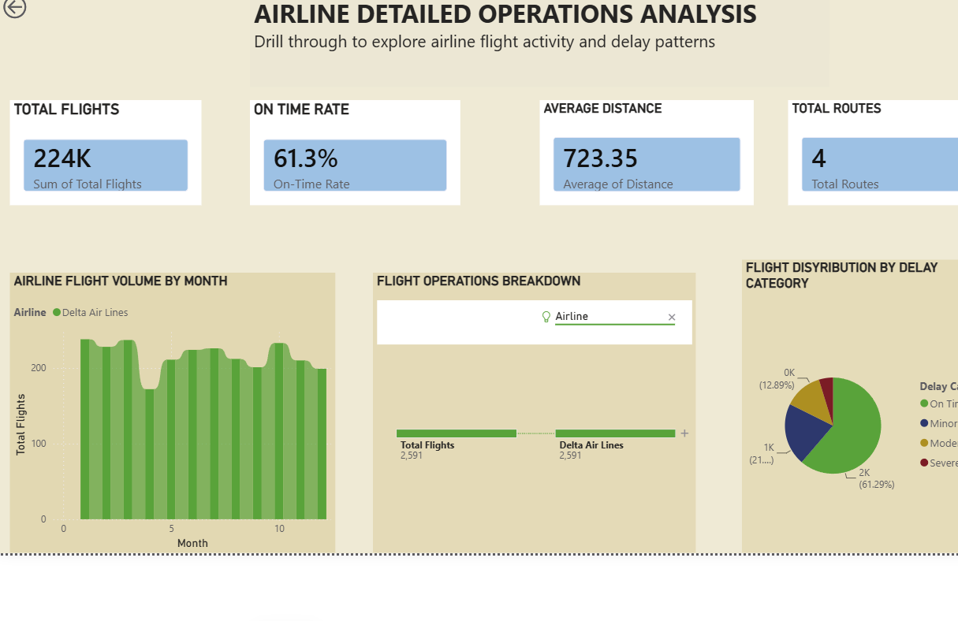
Delta Air Lines — Dashboard Summary
Total Flights: 224K
On-Time Rate: 61.3%
Average Distance: 723.35
Total Routes: 4
The on-time rate of 61.3% indicates that there is still room for improvement in airline schedule reliability.
DSA 3050A · Group 05 — Airline Delay & Operations Intelligence
52

Slide 49
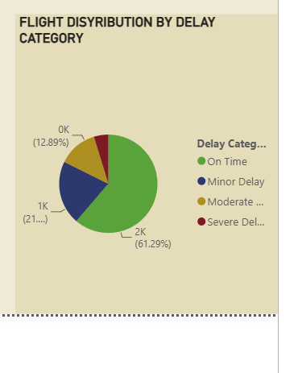
3. Delay Category Analysis
The pie chart shows Delta's flight distribution by delay category
On Time: 61.29%
Minor Delay: approximately 21%
Moderate Delay: approximately 12.9%
Severe Delay: approximately 4%
The majority of flights were on time, while severe delays represented the smallest category.
DSA 3050A · Group 05 — Airline Delay & Operations Intelligence
53

Slide 50
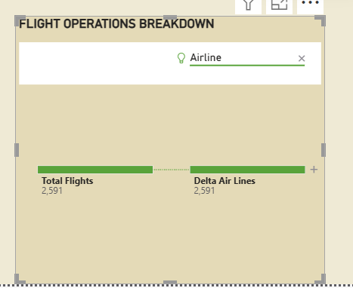
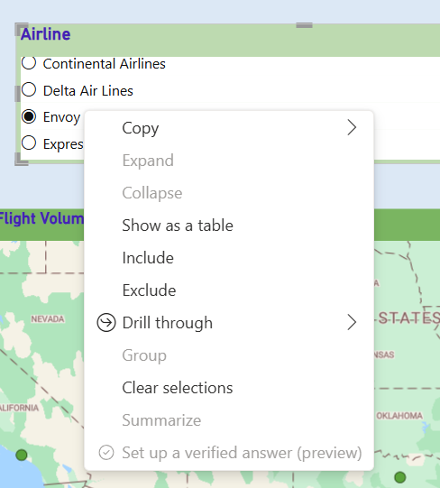
4. Decomposition Tree and Drill-through
The decomposition tree allows total flights to be broken down by airline, destination, month, flight status and delay category. This makes it easier to investigate the factors behind flight activity. The drill-through feature allows users to select an airline from the main dashboard and automatically move to a detailed airline analysis page.
DSA 3050A · Group 05 — Airline Delay & Operations Intelligence
54

Slide 51
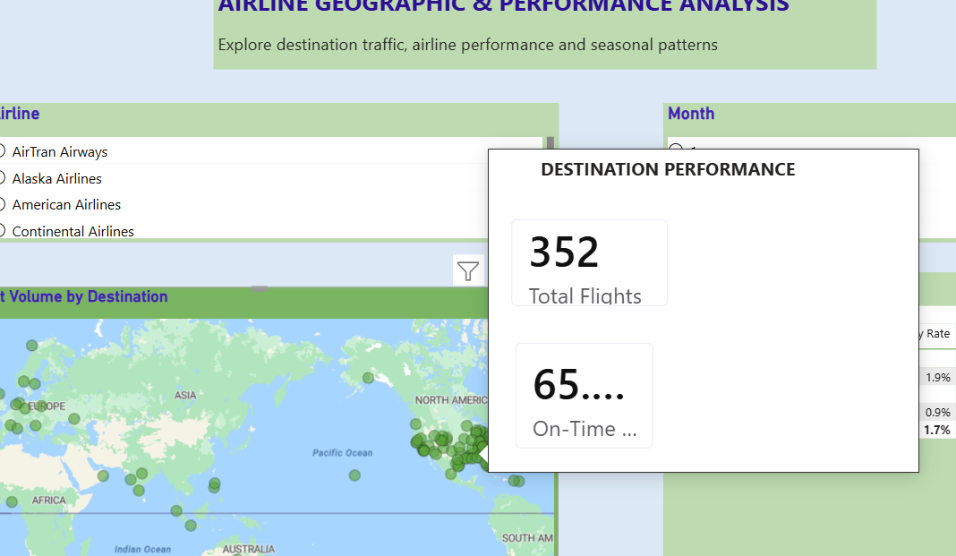
5. Custom Tooltip
A custom tooltip was added to provide additional information when users hover over a visual without overcrowding the dashboard.
DSA 3050A · Group 05 — Airline Delay & Operations Intelligence
55

Slide 52
Conclusion
Overall, the dashboard shows that airline operations vary by destination, airline and month. Flight volume is concentrated in certain destinations, while airline performance and delay rates differ between carriers. The interactive drill-through, decomposition tree and tooltip allow users to move from general information to detailed airline analysis and identify areas that may require improvement.
DSA 3050A · Group 05 — Airline Delay & Operations Intelligence
56

Slide 53
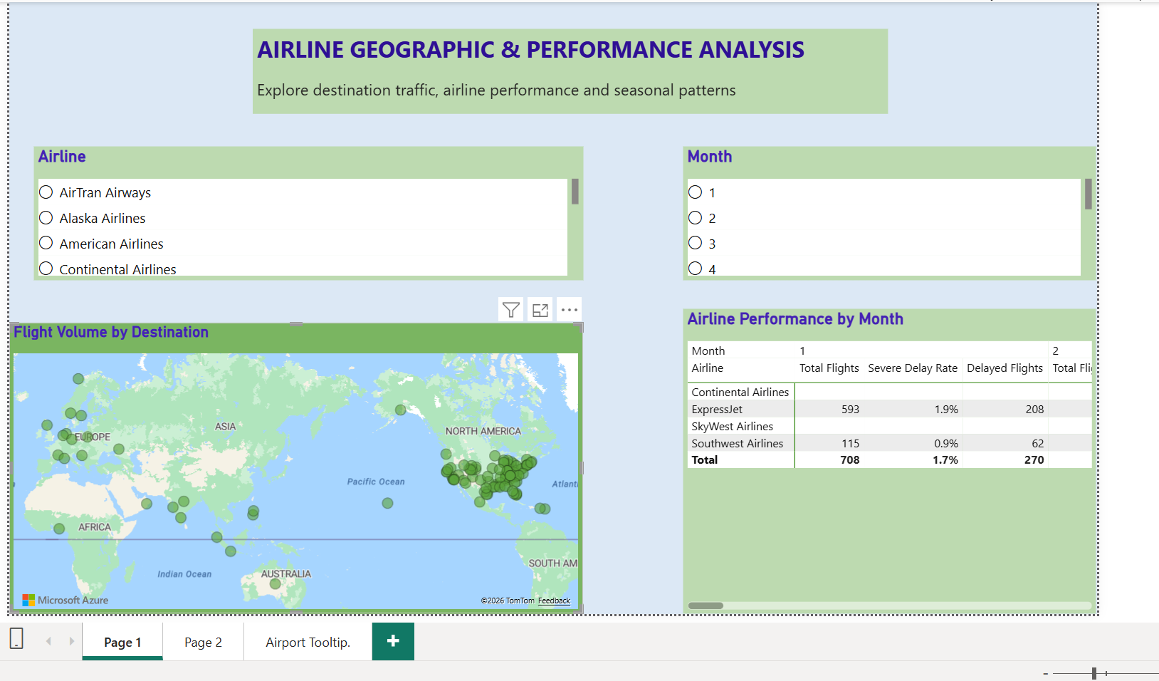
Dashboard Visuals — Figure 1: Geographic and Segment Analysis
This page presents the geographic distribution of flight activity and allows airline performance to be compared across different months.
DSA 3050A · Group 05 — Airline Delay & Operations Intelligence
57

Slide 54
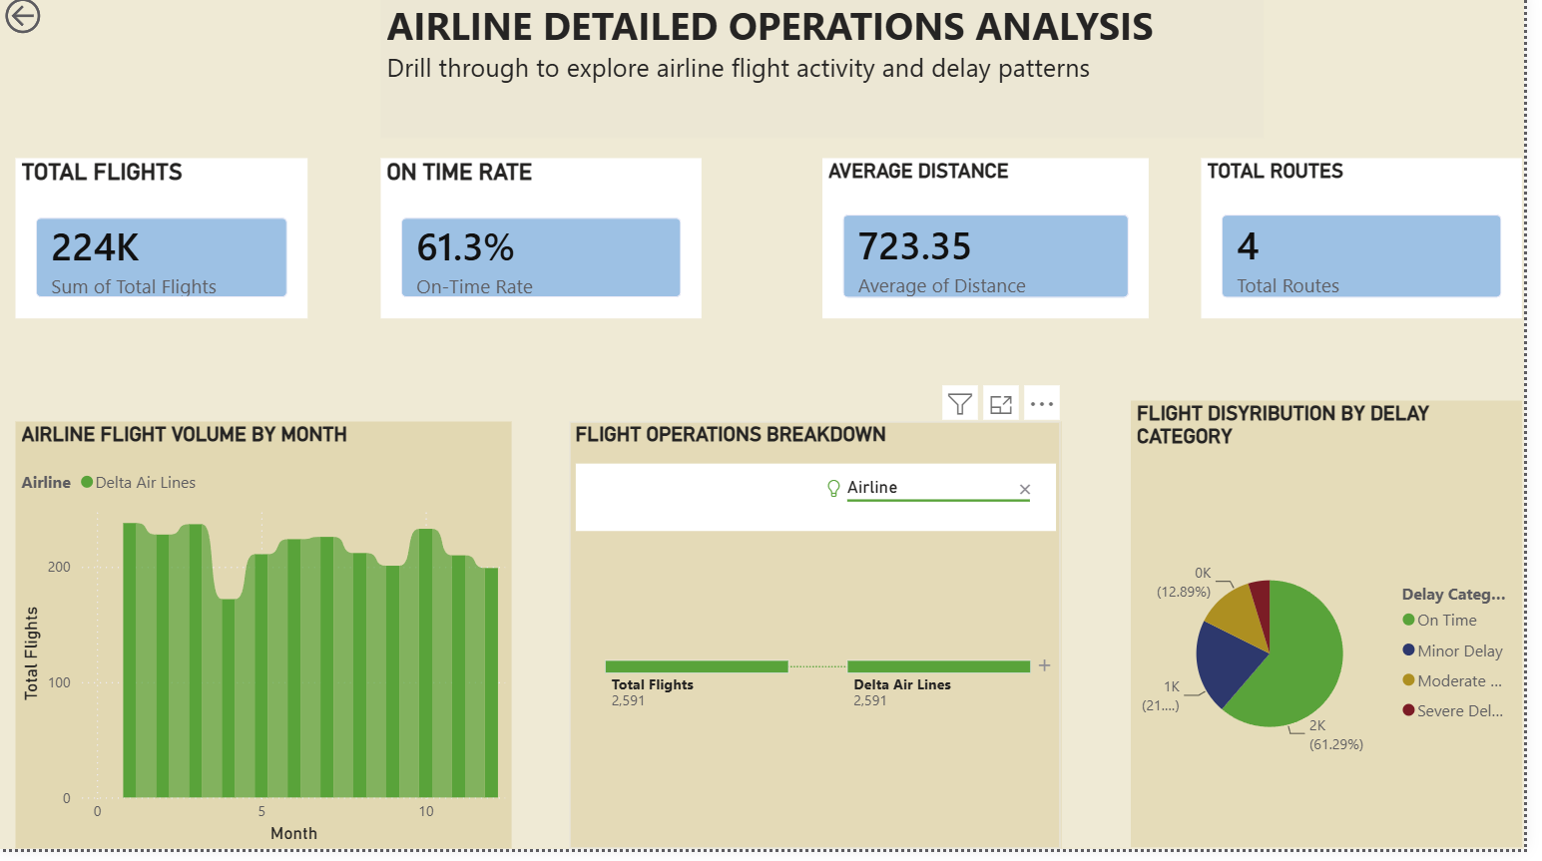
Figure 2: Detailed Airline Operations — Page 4
Figure 2: Airline Detailed Operations Analysis Dashboard. This page provides detailed information about the selected airline, including total flights, on-time rate, average distance, routes, monthly activity and delay categories.
DSA 3050A · Group 05 — Airline Delay & Operations Intelligence
58

Slide 55
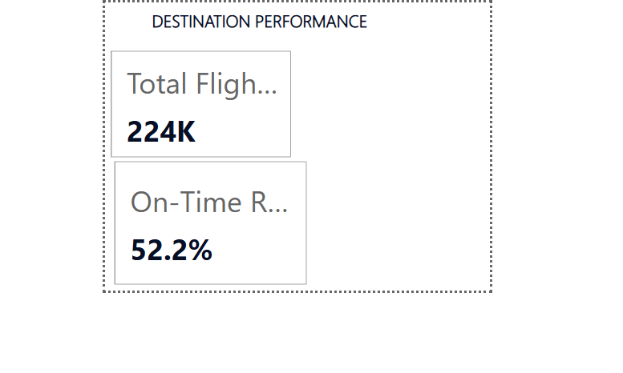
Figure 3: Custom Tooltip
Figure 3: Custom Tooltip Showing Additional Destination Performance Information
DSA 3050A · Group 05 — Airline Delay & Operations Intelligence
59

Slide 56
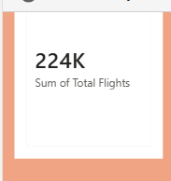
AirTran Airways — Q1 2011 Total Flights
For AirTran Airways in the first quarter of 2011, the dashboard recorded a total of 224,000 flights. This is the baseline volume figure used for the other Executive Summary measures in this filtered view.
DSA 3050A · Group 05 — Airline Delay & Operations Intelligence
60

Slide 57
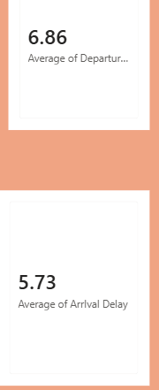
Insight 2: Average Departure and Arrival Delay
The average departure delay for AirTran Airways in Q1 2011 is 6.86 minutes, while the average arrival delay is lower at 5.73 minutes. This gap suggests that although flights tend to leave a few minutes late on average, the airline generally makes up a small amount of that time in the air, arriving slightly closer to schedule than it departs.
DSA 3050A · Group 05 — Airline Delay & Operations Intelligence
61

Slide 58

Insight 3: Cancellations
The dashboard shows 0 cancelled flights for AirTran Airways in this period. This is a strong result, indicating that during Q1 2011 the airline maintained full operational reliability with no recorded cancellations, at least within the filtered view.
DSA 3050A · Group 05 — Airline Delay & Operations Intelligence
62

Slide 59
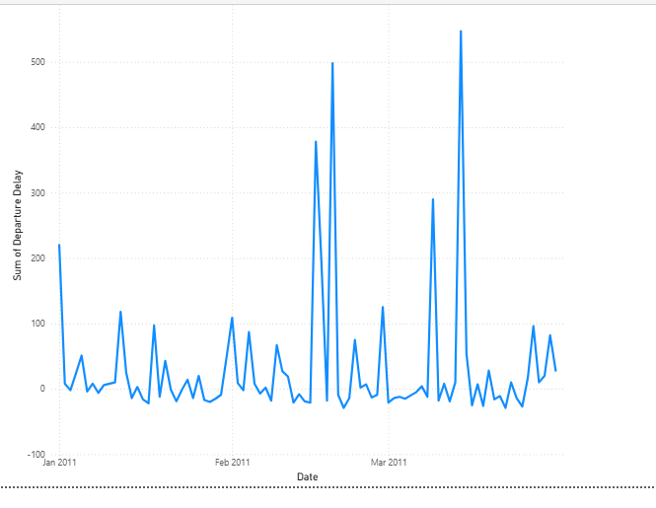
Insight 4: Delay Spikes Over Time
The trend chart for January to March 2011 shows that daily departure delays generally stay low, fluctuating between 0 and 100 minutes on most days, aside from an early spike near 220 minutes in January. From February onward, several sharp spikes stand out, reaching roughly 380, 500, and 545 minutes on individual days, with the highest spike occurring in March. This pattern points to isolated severe-delay days rather than a steady elevated delay level, meaning the 6.86-minute average delay figure alone hides these extreme outlier days.
DSA 3050A · Group 05 — Airline Delay & Operations Intelligence
63

Slide 60
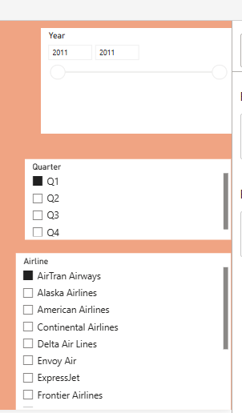
Insight 5: Scope of Current View
All figures above reflect AirTran Airways only, filtered to Q1 2011, since these were the only Airline and Quarter selections active on the dashboard when these values were captured. A full, unfiltered view across all airlines and all quarters is needed to confirm whether AirTran Airways' performance is typical or an outlier compared to the rest of the dataset.
DSA 3050A · Group 05 — Airline Delay & Operations Intelligence
64

Slide 61
Part 6: Insights, Recommendations and Storytelling

Slide 62
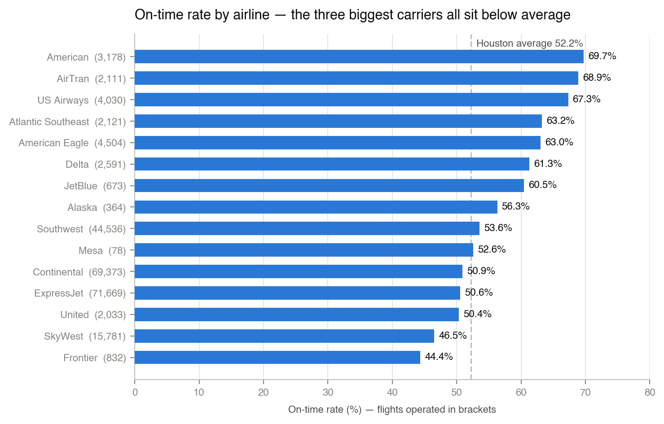
Insight 1 — Punctuality Is Inversely Related to Scale
Three carriers fly 82% of Houston. All three run at or below the 52.2% average. Improving the other twelve cannot move the system.
DSA 3050A · Group 05 — Airline Delay & Operations Intelligence
66

Slide 63
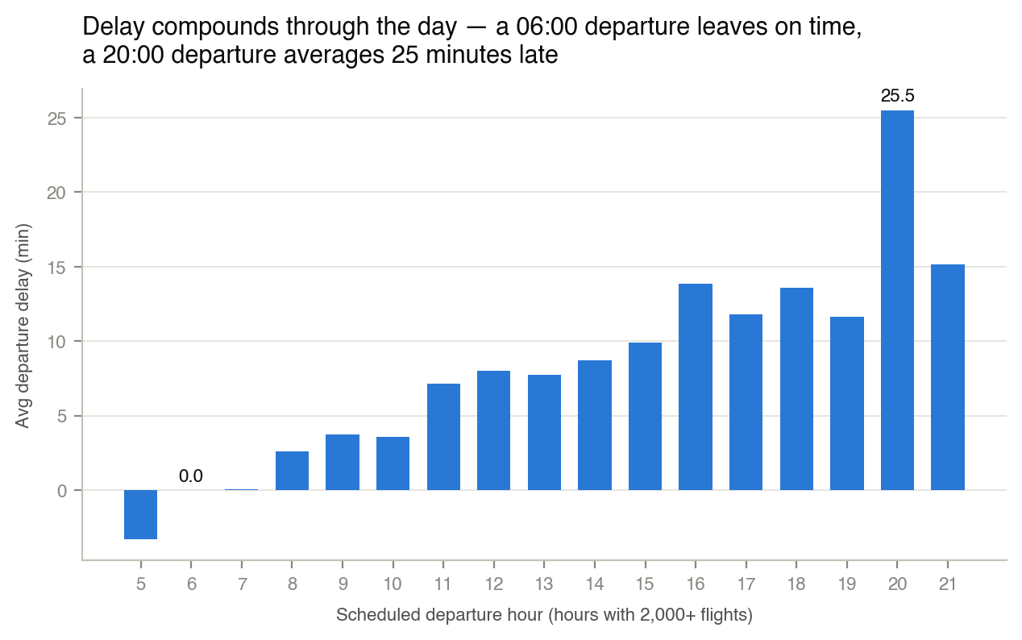
Insight 2 — Delay Is Manufactured During the Day
06:00 departs on time. 20:00 averages 25.5 minutes late. Same aircraft, same crews, same routes — delay compounds across rotations.
DSA 3050A · Group 05 — Airline Delay & Operations Intelligence
67

Slide 64
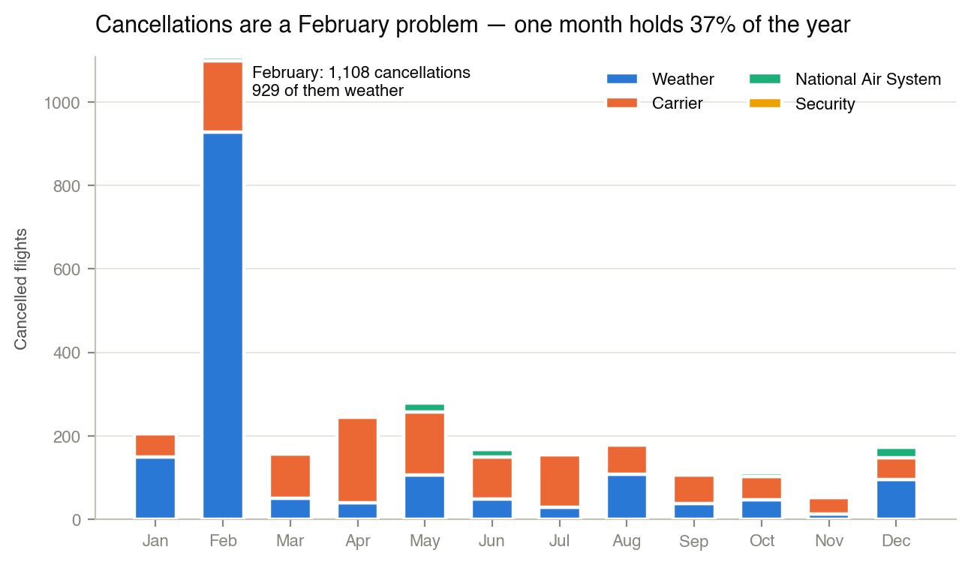
Insight 3 — Cancellations Are One Week in February
1,108 of 2,973 cancellations fall in February. Strip it out and the network cancels 0.89% — a well-run operation.
DSA 3050A · Group 05 — Airline Delay & Operations Intelligence
68

Slide 65
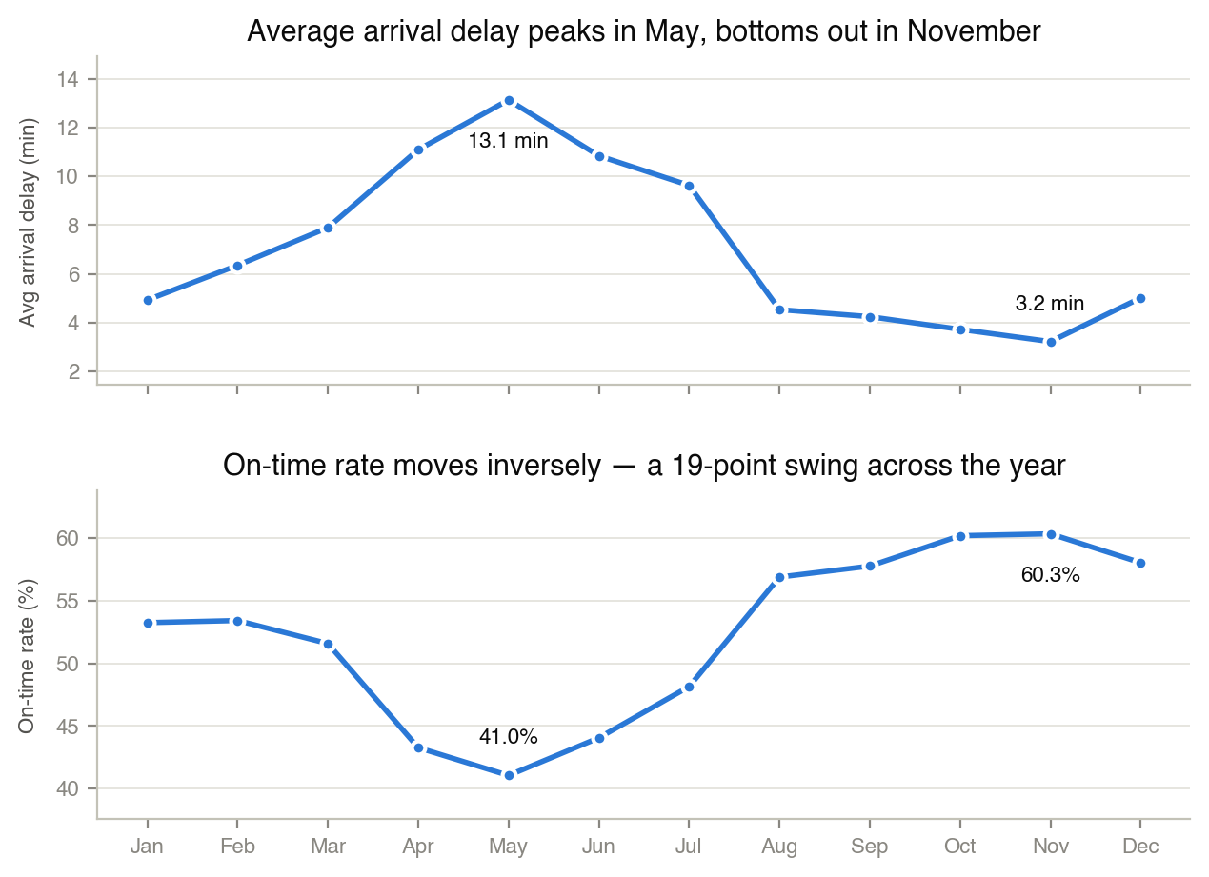
Insight 4 — Delay Peaks in May, Traffic Peaks in July
Volume does not predict delay: r = 0.33. Contingency staffing is aligned to the wrong month.
DSA 3050A · Group 05 — Airline Delay & Operations Intelligence
69

Slide 66
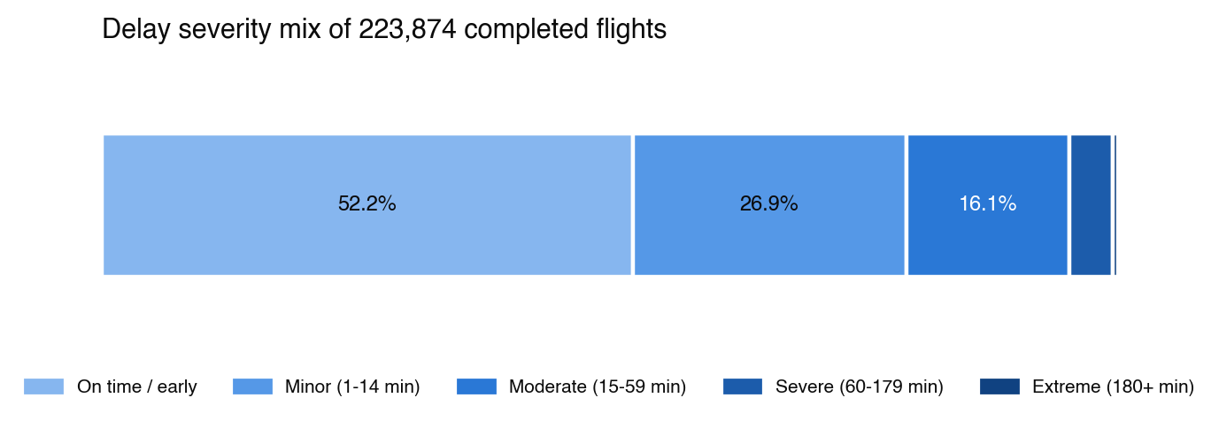
Insight 5 — A Thin Tail Does the Damage
79% of flights are effectively fine. The cost sits in the 4.7% — 10,584 flights — that arrive an hour or more late, of which 1,110 are over three hours late. An average-delay target chases the harmless middle.
DSA 3050A · Group 05 — Airline Delay & Operations Intelligence
70

Slide 67
What We Recommend
Six recommendations, traced to the evidence
# | Recommendation | Why
1 | Target the three high-volume carriers | Moving them nine points moves the whole system seven. Perfecting the other twelve moves it under three.
2 | Protect the morning bank | Delay compounds from 06:00. The earliest minute saved is the cheapest.
3 | Fix HOU's turnaround, not its taxiways | Half the taxi time, more departure delay. The gate is the constraint.
4 | Separate February from the cancellation baseline | The blended rate hides a good operation and misnames the dominant cause.
5 | Target severe-delay rate, not average delay | Aims at the 10,584 flights that break connections, not at noise.
6 | Load-plan for May, not July | Align contingency with when the network fails, not when it is busiest.
DSA 3050A · Group 05 — Airline Delay & Operations Intelligence
71

Slide 68
Where This Leaves Houston
Houston does not have a general punctuality problem. It has three addressable problems and one unavoidable one.
Unavoidable: February. One ice storm, 37% of the year's cancellations.
Concentration: three carriers are the system.
Compounding: delay is created hour by hour, not inherited.
Measurement: the current metrics point management at the least actionable part of all three.
The cheapest recommendation — change what is measured — costs nothing and unlocks the value of the other five.
DSA 3050A · Group 05 — Airline Delay & Operations Intelligence
72

Slide 69
Recommendations for the Dashboard
Investigate the specific days behind the three major delay spikes (around 500, 380, and 545 minutes) in Q1 2011 to identify whether they were caused by weather, mechanical issues, or operational disruptions, since these outliers have a bigger impact on passengers than the 6.86-minute average suggests.
Set up daily delay alerts for any day where departure delay exceeds a set threshold (for example, 150 minutes), so severe-delay days like the ones seen in January and February 2011 are caught and addressed in real time rather than only in quarterly review.
Maintain the current zero-cancellation standard by documenting what operational practices kept cancellations at 0 in Q1 2011, and apply the same practices across other quarters and airlines.
Compare AirTran Airways' 6.86-minute average departure delay against the other airlines in the dataset (Alaska, American, Delta, Frontier, and others) to determine whether this performance is above or below industry average within the dataset.
Expand this analysis to a full-year, all-airline view before presenting to senior management, since the current figures are limited to one airline and one quarter and may not represent overall performance.
DSA 3050A · Group 05 — Airline Delay & Operations Intelligence
73

Slide 70
Thank You
Questions

